Slide 1
JSON vs XML

Slide 2
JSON (JavaScript Object Notation)
Data Representation Format
Commonly Used for APIs and Configs
Lightweight and Easy to Read/Write
Integrates Easily with most Programing language

Slide 3
JSON Types
Strings “Hello World” “I”
Numbers 10 1.5 -30 1.2e10
Booleans True False
Null Null
Arrays [1,2,3] [“Hello”, “World”]
Objects { “key” : “Values”} {“age” : 30 }

Slide 4
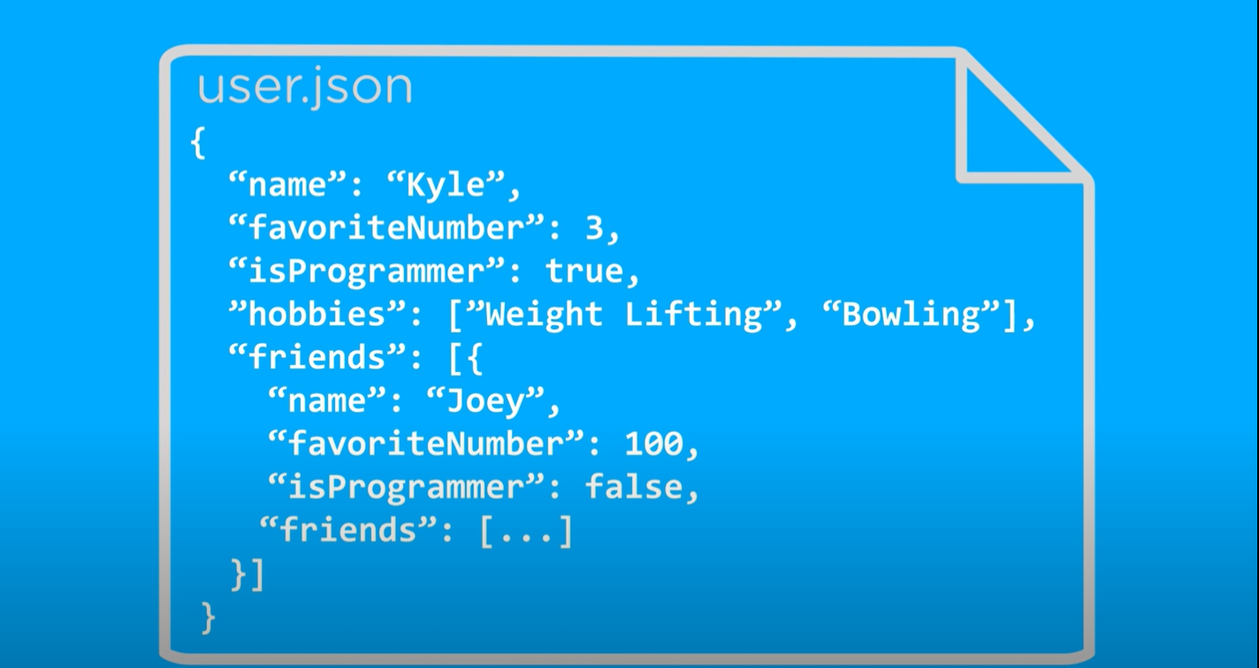
Example of JSON file

Slide 5
XML (eXtensible Markup Language)
XML is a markup language much like HTML
XML was designed to store and transport data
XML was designed to be self-descriptive

Slide 6
XML Example
<note> <to>Tove</to> <from>Jani</from> <heading>Reminder</heading> <body>Don't forget me this weekend!</body> </note>
This note is a note to Tove from Jani, stored as XML

Slide 7
JSON is Like XML Because
Both JSON and XML are "self describing" (human readable)
Both JSON and XML are hierarchical (values within values)
Both JSON and XML can be parsed and used by lots of programming languages
Both JSON and XML can be fetched with an XMLHttpRequest

Slide 8
JSON is Unlike XML Because
JSON doesn't use end tag
JSON is shorter
JSON is quicker to read and write
JSON can use arrays

Slide 9
Why JSON is Better Than XML
XML is much more difficult to parse than JSON.
JSON is parsed into a ready-to-use JavaScript object.
For AJAX applications, JSON is faster and easier than XML:
Using XML
Fetch an XML document
Use the XML DOM to loop through the document
Extract values and store in variables
Using JSON
Fetch a JSON string
JSON.Parse the JSON string

